Slide 1



Project 1
02- 26 -2025
Group 9: Bibek Adhikari, Sai Ram Vodnala

Slide 2
Introduction
Typing Dynamics
Study Design:
Project Goal:
The project is focused on
enhancing password-based
security systems by
incorporating typing dynamics
as a biometric feature.
Keystroke dynamics can provide an additional layer of security by analyzing unique typing behaviors.
Passcode: “.tie5Roanl” – designed as a strong, representative password.
Subjects: 51 participants recruited at Carnegie Mellon University (CMU).
Sessions: 8 sessions, 1 per day.
Repetitions: Each subject typed the passcode 50 times per session.
analyze users typing
dynamics (keystroke
timing) to identify a
threshold for when a
system can start
recognizing "learned"
typing behaviors.

Slide 3
Participant and Password Details
Participant Demographics:
51 subjects:
30 males, 21 females
8 left-handed, 43 right-handed
Age range: 18–70 years (Median: 31–40 years).
Password Design:
Created using a password generator and strength checker.
Criteria:
10 characters (letters, numbers, punctuation).
Modified for punctuation and casing to reflect a “strong” password.
Rated strong because it includes:
More than 7 characters
A capital letter
A number
Punctuation
The top rating requires >13 characters, but 10 characters is typical in real-world studies.

Slide 4
Dataset Overview
Dataset Overview:
20,400 observations and 34 variables.
Provides a robust foundation for analysis.
Dataset Variables and Timing Definitions
Hold Time (H):
Duration a key is held down (e.g., H.period, H.t, H.Return).
Down-Down Time (DD):
Time between pressing down one key to pressing down another subsequent key.
Examples:
DD.period.t: From pressing "." to pressing "t".
DD.a.n: From pressing "a" to pressing "n".
Up-Down Time (UD):
Time from releasing one key to pressing down the next key.
Examples:
UD.period.t: From releasing "." to pressing "t".
UD.n.l: From releasing "n" to pressing "l".

Slide 5
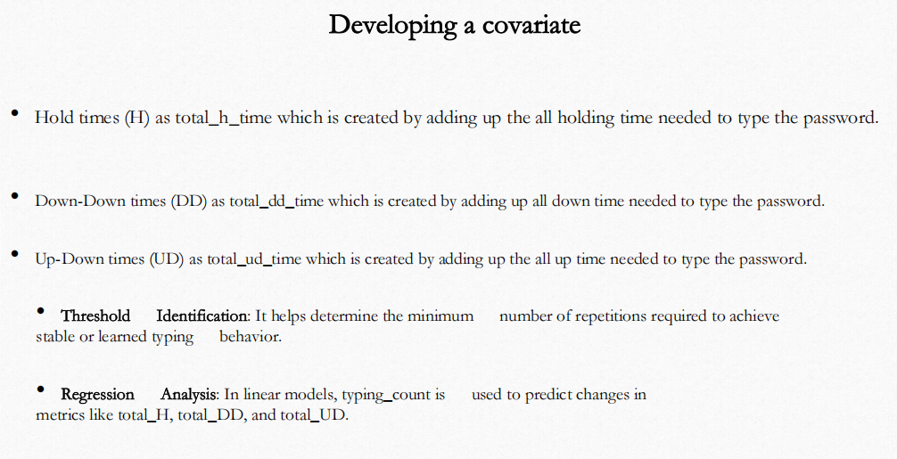

Slide 6
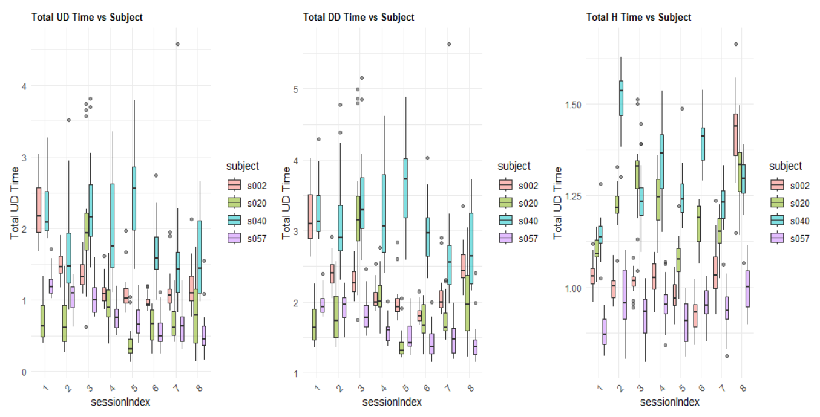
Filtering to the last 20 (keep only 31 to 50 ) attempts for each subject within each session.

Slide 7
Building the Regression Models:
Dependent Variables: total_UD, total_DD, and total_H.
Independent Variable: typing_count and sessionIndex
Linear models are used
1. Up-Down Time Model
total_ud_time=β0​+β1​⋅typing_count+β2​⋅sessionIndex
2. Down-Down Time Model
total_dd_time=β0​+β1​⋅typing_count+β2​⋅sessionIndex
3. Hold Time Model
total_h_time=β0​+β1​⋅typing_count+β2​⋅sessionIndex

Slide 8
Results:
Model | Typing Count Coefficient | Session Index Coefficient | Significance of Session Index | R² (Model Fit)
Up-Down Time (UD) | 0.00187 (p = 0.347) | -0.2052 (p = 0.0393) | Significant (faster over sessions) | 0.057
Down-Down Time (DD) | 0.00234 (p = 0.224) | -0.2198 (p = 0.0226) | Significant (faster over sessions) | 0.052
Hold Time (H) | 0.00055 (p = 0.227) | -0.0181 (p = 0.424) | Not Significant | 0.0082
Insight | Observation | Impact
Typing Speed Improves Over Sessions | UD and DD times decrease as session index increases. | Users develop some memory and type faster.
Hold Time Remains Constant | No significant decrease in hold time across sessions. | Users consistently hold keys for the same duration, even as they improve overall typing speed.
Low R² Values (Weak Model Fit) | R² values are low, especially for hold time (0.0082). | Other factors might influence typing behavior.

Slide 9
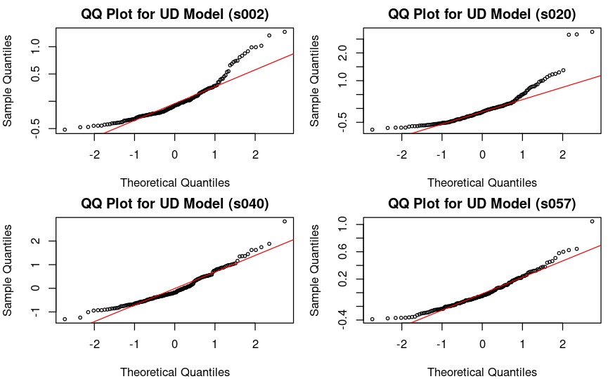
QQ Plots for Normality Residuals
#QQ plot for UD model

Slide 10
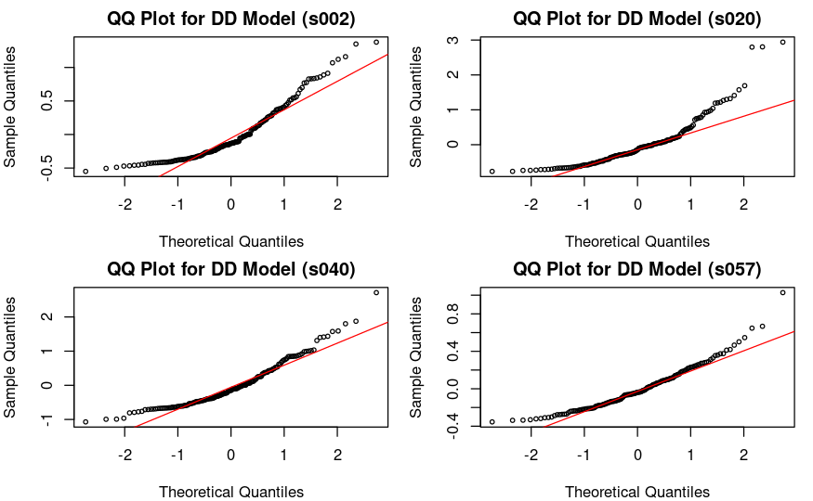
#QQ plot for DD model

Slide 11
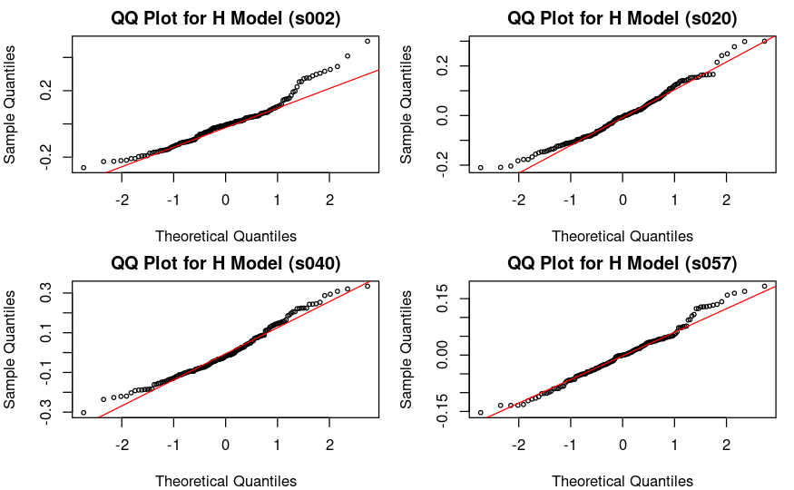
##QQ plot for H model

Slide 12
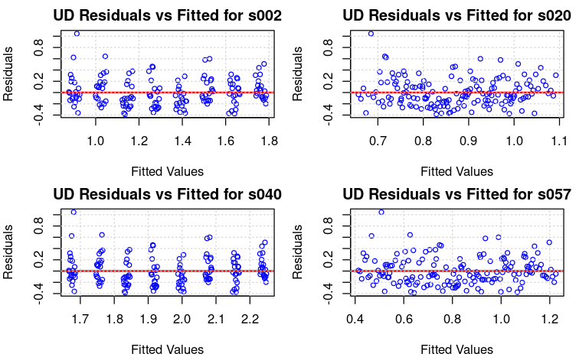
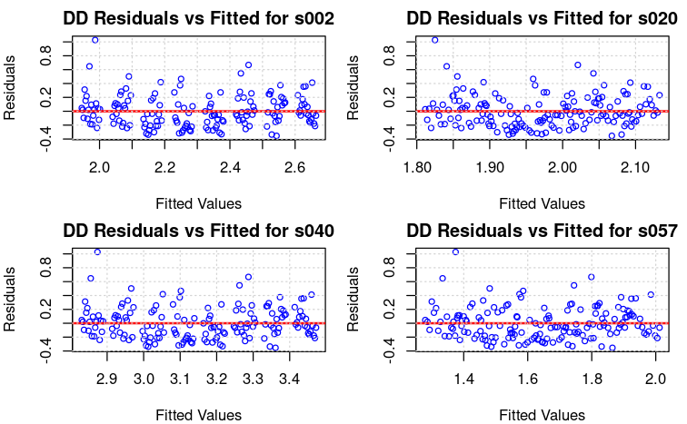
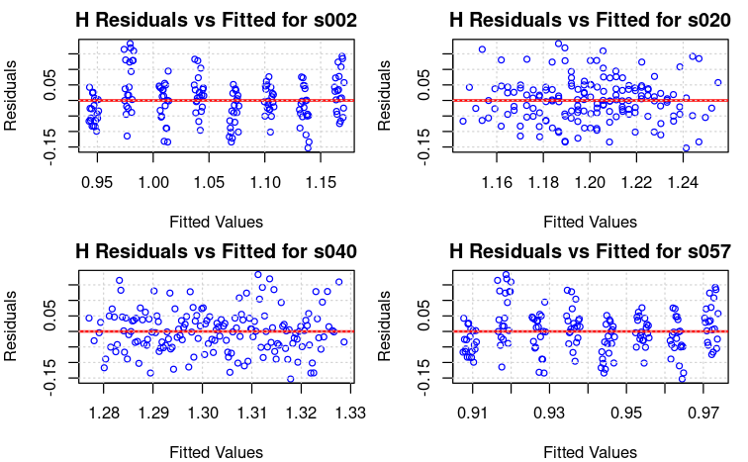
#Residuals vs Fitted plot for UD
#Residuals vs Fitted plot for DD
#Residuals vs Fitted plot for H

Slide 13
#Shapiro-Wilk Test for Normality Distribution
Before False Discovery Rate (FDR)
After False Discovery Rate (FDR)
Subject | Model | W-statistic | p-value | Normality Conclusion
s002 | UD | 0.8889 | 1.37E-09 | Not normal
s020 | UD | 0.8329 | 3.07E-12 | Not normal
s040 | UD | 0.9448 | 6.59E-06 | Not normal
s057 | UD | 0.9474 | 1.08E-05 | Not normal
s002 | DD | 0.886 | 9.49E-10 | Not normal
s020 | DD | 0.8334 | 3.22E-12 | Not normal
s040 | DD | 0.9221 | 1.37E-07 | Not normal
s057 | DD | 0.9383 | 2.02E-06 | Not normal
s002 | H | 0.953 | 3.31E-05 | Not normal
s020 | H | 0.98 | 0.0204 | Almost normal
s040 | H | 0.9768 | 0.0085 | Almost normal
s057 | H | 0.9857 | 0.0993 | Normal
Subject | Model | W-statistic | p-value | FDR-adjusted p-value | Normality Conclusion After FDR
s002 | UD | 0.8889 | 1.37E-09 | 4.11E-09 | Not normal
s020 | UD | 0.8329 | 3.07E-12 | 1.93E-11 | Not normal
s040 | UD | 0.9448 | 6.59E-06 | 1.13E-05 | Not normal
s057 | UD | 0.9474 | 1.08E-05 | 1.62E-05 | Not normal
s002 | DD | 0.886 | 9.49E-10 | 3.80E-09 | Not normal
s020 | DD | 0.8334 | 3.22E-12 | 1.93E-11 | Not normal
s040 | DD | 0.9221 | 1.37E-07 | 3.29E-07 | Not normal
s057 | DD | 0.9383 | 2.02E-06 | 4.04E-06 | Not normal
s002 | H | 0.953 | 3.31E-05 | 4.41E-05 | Not normal
s020 | H | 0.98 | 0.0204 | 0.0223 | Almost normal
s040 | H | 0.9768 | 0.0085 | 0.0102 | Almost normal
s057 | H | 0.9857 | 0.0993 | 0.0993 | Normal

Slide 14
Log transformation
Shapiro-Wilk tests, residuals for UD and DD models were heavily skewed.
Log transformation helps normalize distributions by reducing the impact of extreme values.
Table: Shapiro-Wilk Test Results for Log-Transformed UD and DD Models
Subject | Model | W-statistic | P-Value | FDR Adjusted P-Value | Normality Conclusion
s002 | Log_UD | 0.94909 | 1.67E-10 | 3.33E-10 | Not Normal
s002 | Log_DD | 0.9384 | 8.16E-12 | 2.18E-11 | Not Normal
s020 | Log_UD | 0.95286 | 5.34E-10 | 8.54E-10 | Not Normal
s020 | Log_DD | 0.93343 | 2.26E-12 | 9.02E-12 | Not Normal
s040 | Log_UD | 0.98658 | 9.39E-04 | 9.39E-04 | Approximately Normal
s040 | Log_DD | 0.96776 | 1.02E-07 | 1.17E-07 | Not Normal
s057 | Log_UD | 0.95914 | 4.24E-09 | 5.65E-09 | Not Normal
s057 | Log_DD | 0.92497 | 2.90E-13 | 2.32E-12 | Not Normal

Slide 15
Conclusions:
Typing Behavior Becomes More Consistent Over Time
Filtering the last 20 attempts per session reduced variability and noise, making typing behavior more stable.
Up-Down (UD) and Down-Down (DD) times show a clear decreasing trend, indicating that users improve their typing speed with repeated sessions.
Hold (H) time remains stable, suggesting that holding duration is an intrinsic characteristic and is not significantly affected by repeated practice.
Regression Analysis Shows Limited Predictive Power
Session Index is a significant predictor for UD and DD times, confirming that users type faster with more sessions.
Low R² values (0.057 for UD, 0.052 for DD, 0.008 for H) indicate that additional factors may be influencing typing dynamics.
Residual Analysis Shows Non-Normality in UD and DD Models
Shapiro-Wilk test and QQ plots indicate that UD and DD residuals are not normally distributed, suggesting skewness or outliers in the data.
Hold time (H) model residuals are closer to normal, meaning the model fits better for this variable.
Log Transformation Improves Some Model Assumptions but Does Not Fully Solve Non-Normality
After applying a log transformation to UD and DD times, s040 (Log_UD) residuals became approximately normal.
Most residuals still show non-normality, meaning log transformation helps but may not be the complete solution.

Slide 16
Recommendations:
Enhancing the Model with Nonlinear Techniques
Since linear models do not fully explain keystroke timing variations, considering Polynomial regression (to capture nonlinearity), Mixed-effects models (to account for subject variability),Machine learning models (Random Forests, Neural Networks) for better predictions.
Using Outlier Detection and Robust Regression

Slide 17
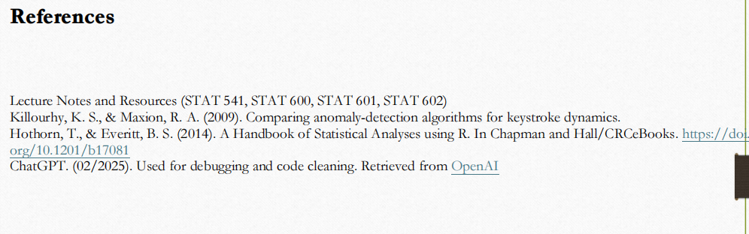

Slide 18
Thank you!

